Slide 1
Theory of Computation
Quantum Computation
Animations
Dr Shekhar “Shakes” Chandra shekhar.chandra@uq.edu.au
V1.0

Slide 2
Superposition
Figures from Wikipedia: Superposition and Wavefunction

Slide 3
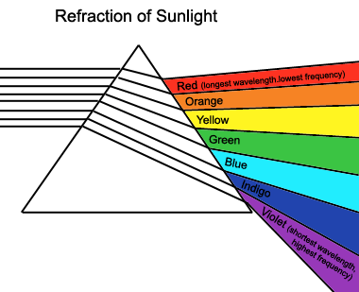
Fourier Transform
White light
(all wavelengths)
Colour
spectrum
f= 1/λ
Think of a Fourier Transform like a prism:
“Destructs a source signal into its constituent frequencies”

Slide 4
Fourier Transform
By: Andrés Cabrera and Karl Yerkes. http://w2.mat.ucsb.edu/201A/nb/Sinusoids%20and%20Phasors.html

Slide 5
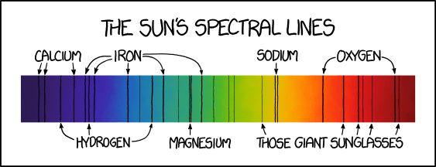
Hydrogen Energy Levels
Figure from xkcd: https://www.explainxkcd.com/wiki/index.php/1733:_Solar_Spectrum

Slide 6
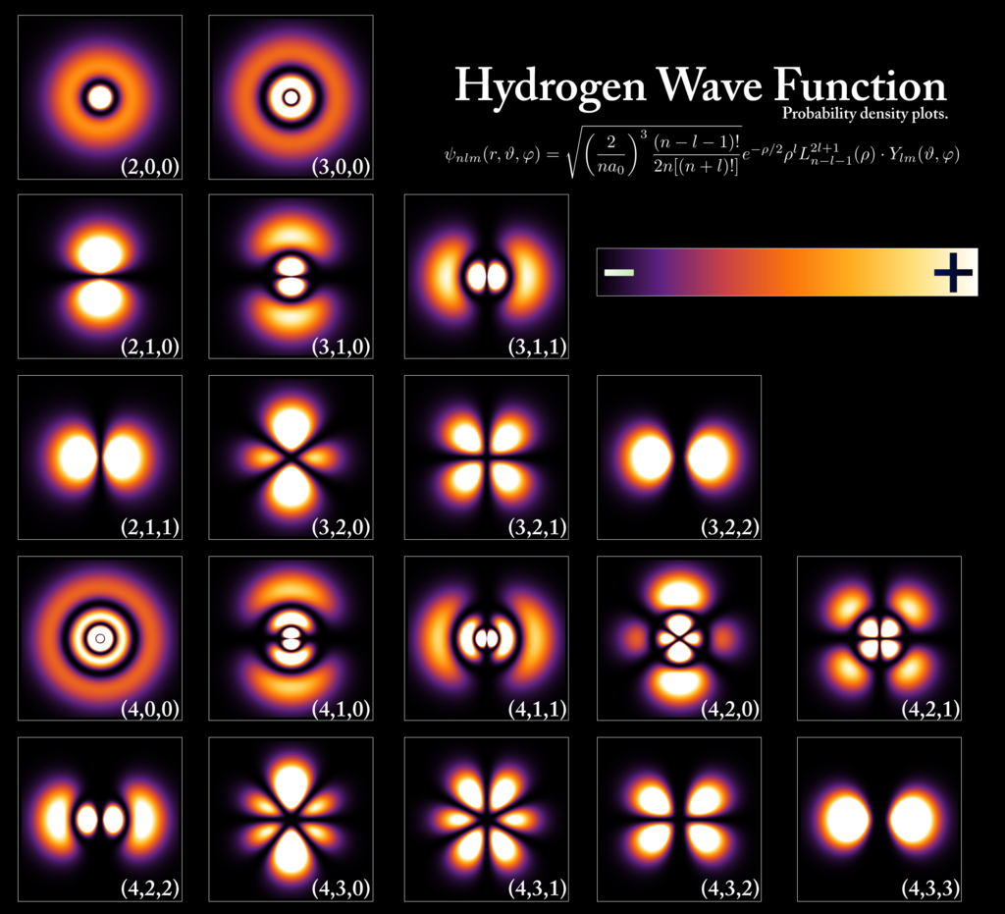
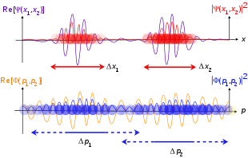
Wavefunction
Figure taken from Wikipedia Wavefunction

Slide 7


Thank you
Dr Shekhar “Shakes” Chandra | Lecturer
School of Information Technology and Electrical Engineering
shekhar.chandra@uq.edu.au
+61 7 3365 8359
@shakes76
shekhar-s-chandra

